Slide 1

Kaun Banega Bollywood ka Badshah

Slide 2
Brain Teasers (2 Rounds)
Correct Answer : 10 pts
Wrong Answer : 0 pts
No passing
Time Limit – 1 min

Slide 3
Round 1

Slide 4
Question 1
In the movie Awara Paga Deewana, Paresh Rawal calls Johnny lever with various funny names. Which of the following names is NOT used in the movie ?
Chota Chatri
Tadpatri
Kaju Katri
Suleiman Khatri
2
3
5
4
1
Time Up

Slide 5
Question 2
In the movie Dil Chahta Hai, Shalini and Akash bump into each other on a flight to Australia. Which city are they travelling to?
1. Sydney
2. Melbourne
3. Canberra
4. Brisbane
5
4
3
2
1
Time Up

Slide 6
Question 3
What is Shah Rukh's mantra to woo a girl in Kal Ho Naa Ho?
1. Che din ladki in
2. Saat din ladki in
3. Paanch din ladki in
3. Teen din ladki in
1
5
4
3
2
Time Up

Slide 7
Question 4
In Herapheri, what number was wrongly associated to “Star Fisheries” in the phone directory ?
1. 8884422
2. 8881212
3. 8662345
4. 8862121
5
4
3
2
1
Time Up

Slide 8
Round 2

Slide 9
Question 5
In the Priyadarshan directed movie "Hulchul" about two warring families, which movie are Anjali (Kareena Kapoor) and her family watching when Jai (Akshaye Khanna) enters the house from the window?
1. Hera Pheri
2. Julie
3. Hungama
4. Bobby
5
4
3
2
1
Time Up

Slide 10
Question 6
In the Film “Drishyam”, where did Vijay and his family go to on October 2nd?
1. Margao
2. Panaji
3. Anjuna
3. Candolim
5
4
3
2
1
Time Up

Slide 11
Question 7
In the movie "Dhoom 2" (sequel to the blockbuster "Dhoom") which Disney movie are Abhishek Bachchan and Aishwarya Rai watching when it is revealed that Aishwarya is Abhishek's informer?
1. Cars
2. Shark Tale
3. Madagascar
4. Aladdin
1
2
3
5
4
Time Up

Slide 12
Question 8
The name of Kajol's character in Sohail Khan's Pyar Kiya Toh Darna Kya was...?
1. Simran
2. Hina
3. Muskaan
4. Anjali
5
4
3
2
1
Time Up

Slide 13
Clue (2 Rounds)
Correct Answer without Clue : 25 pts
Correct Answer with 1 Clue : 15 pts
Correct Answer with 2 Clue : 5 pts
Wrong Answer : -10 pts
No Passing, No Time limit

Slide 14
Round 1

Slide 15
Question 1
Which of the below Bollywood movies has won the most number (13) of Filmfare Awards in a year?
Kaho na pyar hai
Lagaan
Gully Boy
Black
Clue 1
The guy who won Best Supporting Male in this movie recently played as one of the leads in a famous sequel
Clue 2
The movie is based on a rapper

Slide 16
Question 2
The Versatile Bollywood actor Irrfan Khan, who recently passed away, had won National award for which movie?
1. Lunch Box
2. Paan Singh Tomar
3. Maqbool
4. Namesake
Clue 1
The female lead in this movie also starred in a movie which was directed by Anurag Kashyap and was a modern-day take on Devdas
Clue 2
The movie is an Indian Athlete’s biopic

Slide 17
Question 3
Which of the below actors original name is Sunil Kapoor ?
Jeetendra
Shakti Kapoor
Anil Kapoor
Rishi Kapoor
Clue 1
He plays an iconic character in a 1994 movie that has 2 famous character names Amar and Prem
Clue 2
One of his famous dialogues is “Aaaoo Lolitaaa”

Slide 18
Question 4
Which Bollywood personality has been honoured with the Meryl Streep Award for Excellence at the first-ever Women in Film and Television (WIFT-2018) award ceremony?
1. Priyanka Chopra
2. Vidya Balan
3. Deepika Padukone
4. Aishwarya Rai Bachchan
Clue 1
She was the first Indian actress to be a jury member at the Cannes Film Festival
Clue 2
Often referred to as the Most Beautiful Women in the World, she was crowned Miss World in 1994

Slide 19
Round 2

Slide 20
Question 5
This is the only film in Bollywood where Aamir Khan & Shah Rukh Khan shared a frame. Name the film.
Pehla Pehla Pyar
Tum Bin
Aashiq Awara
Pehla Nasha
Clue 1
This movie is Ashutosh Gowariker’s debut as a director
Clue 2
There is a famous song with this name starring Aamir Khan

Slide 21
Question 6
This Bollywood movie was earlier slated to be called High Jump and is said to have been inspired by the biography of the famous Japanese filmmaker named Akiro Kurosawa. Which is the movie being referred to here?
Luck By Chance
Wake up Sid
3 Idiots
Taare Zameen Par
Clue 1
This movie was India’s official entry to Oscars
Clue 2
The movie is directed by Aamir Khan

Slide 22
Question 7
1980’s saw a gradual decline of melody in Hindi film music. During this time a Rajshree Prod film “Maine Pyar Kiya” was a musical hit and saw the revival of hindi film music. Who was the music director of this film ?
Nadeem-Shravan
Raamlaxman
Laxmikant-Pyarelal
Sachin-Jigar
Clue 1
These are the names of male leads in one of the famous movie directed by Farah Khan
Clue 2
Two names from Indian mythology

Slide 23
Question 8
Which of these Bollywood movie was the first movie to cross 100crore earnings (In India)?
Hum Apke hai Kaun
Dilwale Dulhaniya Le Jayenge
Raja Hindustani
Kuch kuch hota hai
Clue 1
This movie is a remake of 1982 Bollywood movie “Nadiya ke Paar”
Clue 2
The main leads plays his iconic character “Prem” in this movie

Slide 24
Round 3 – Guess the song by Emoji

Slide 25
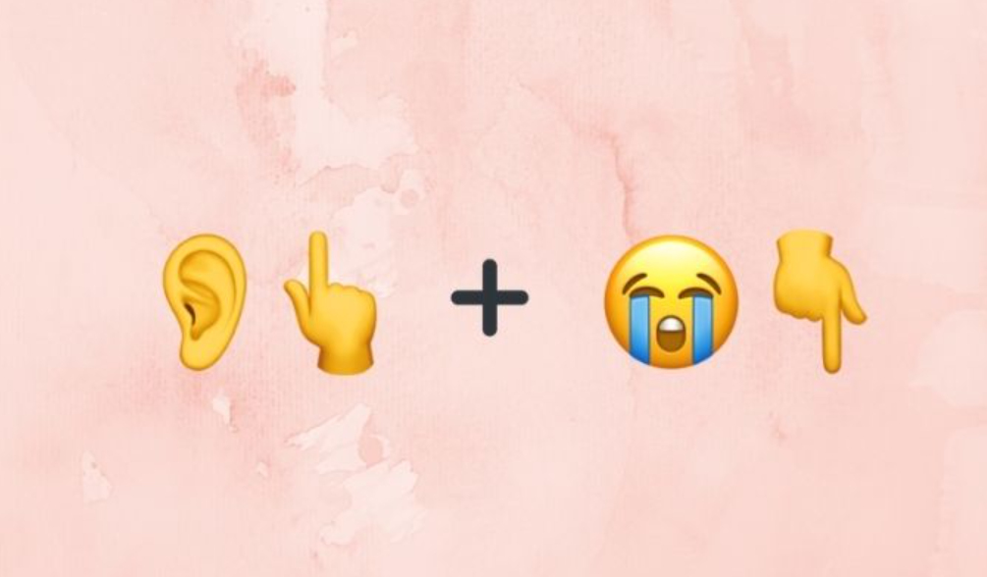
Emoji 1

Slide 26
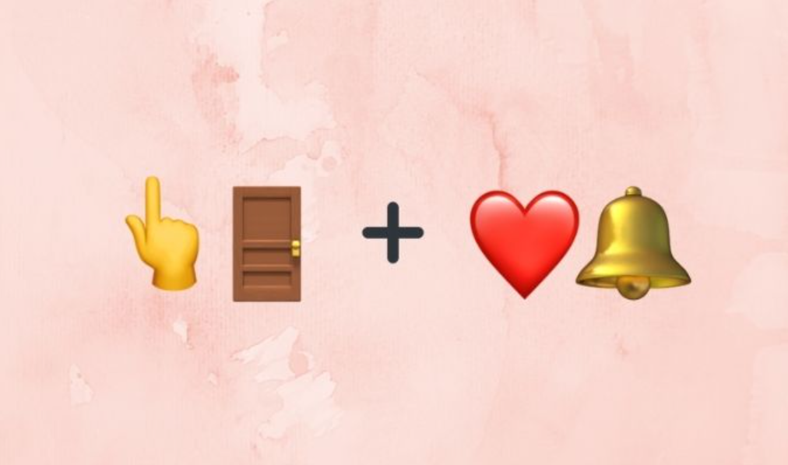
Emoji 2

Slide 27
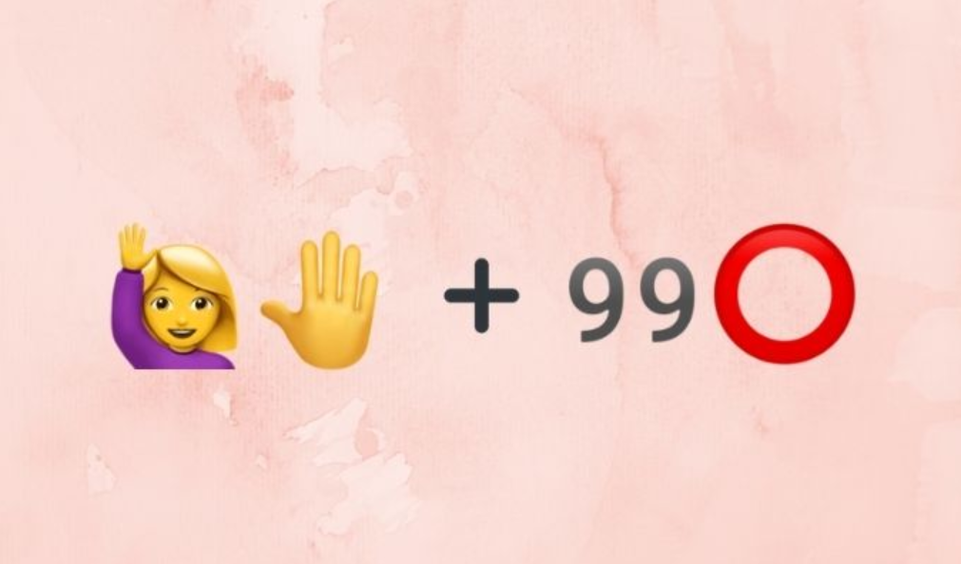
Emoji 3

Slide 28
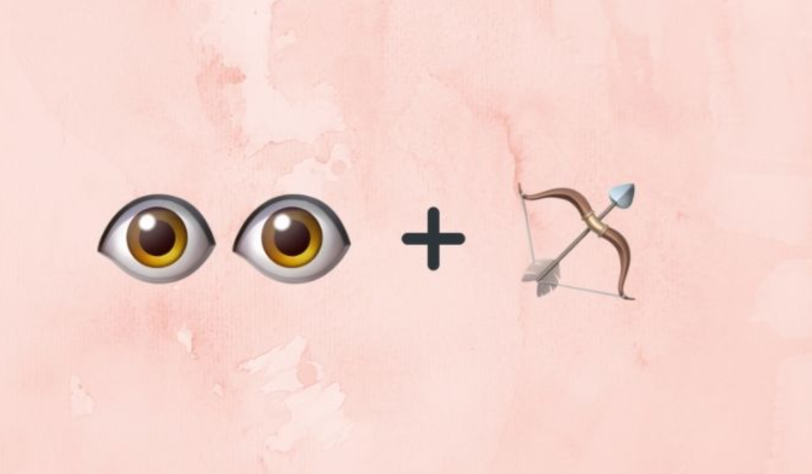
Emoji 4

Slide 29
Round 4 – Guess the movie by Images

Slide 30
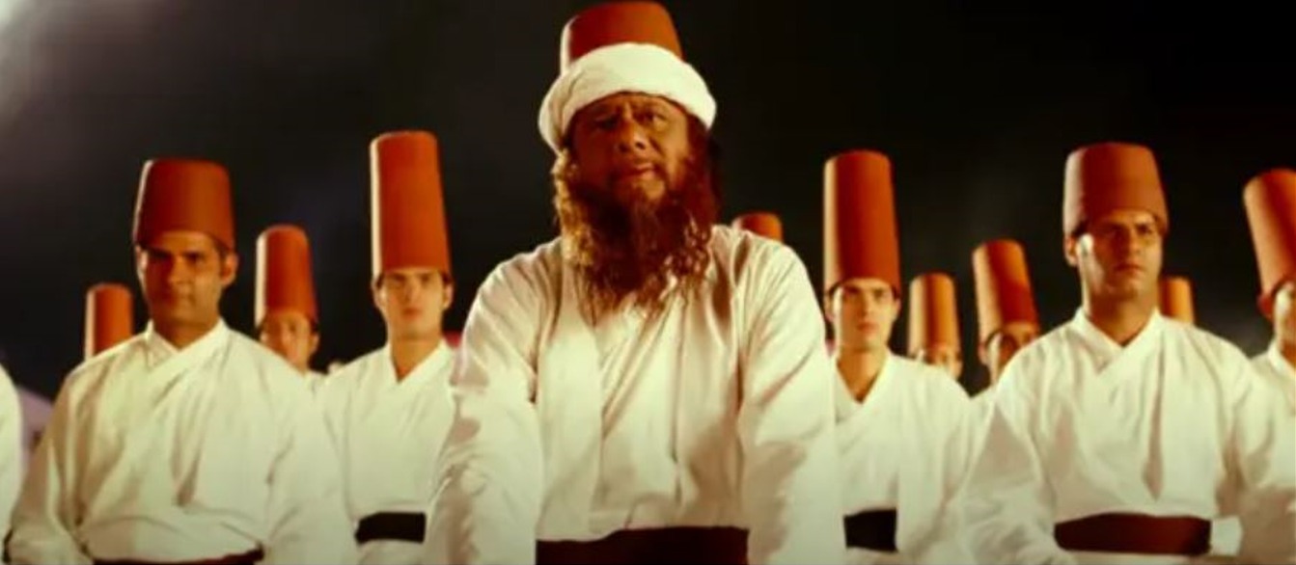
Image 1

Slide 31
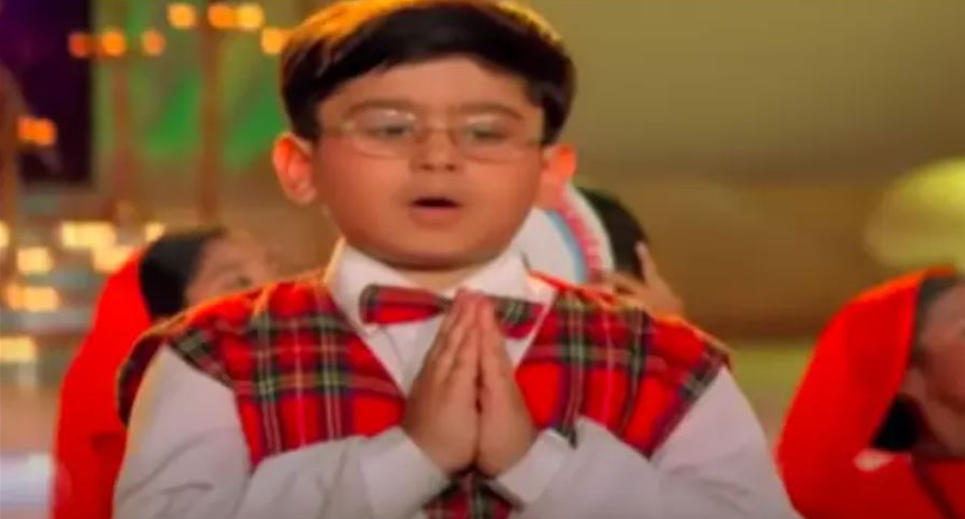
Image 2

Slide 32
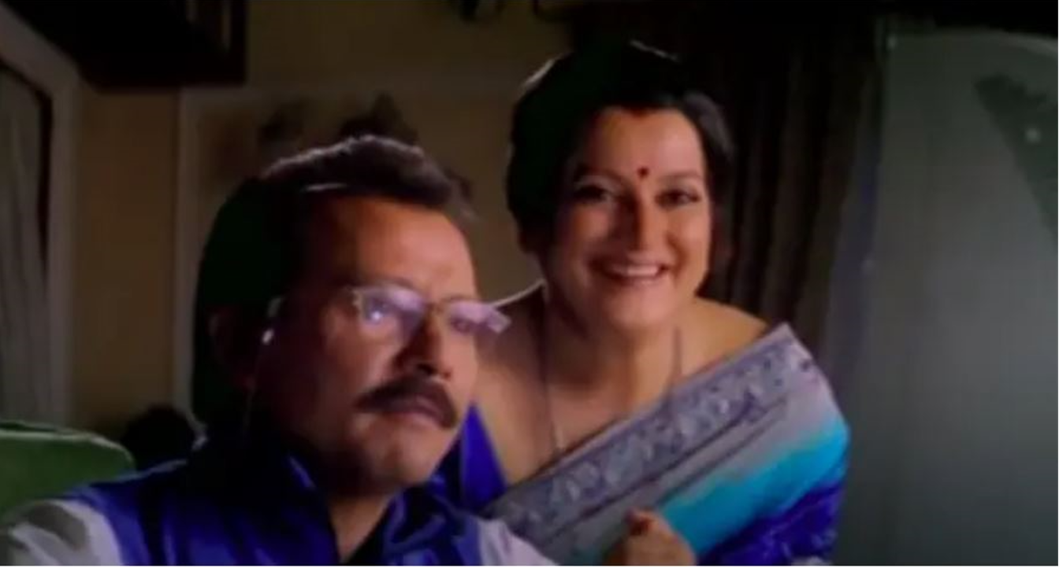
Image 3

Slide 33
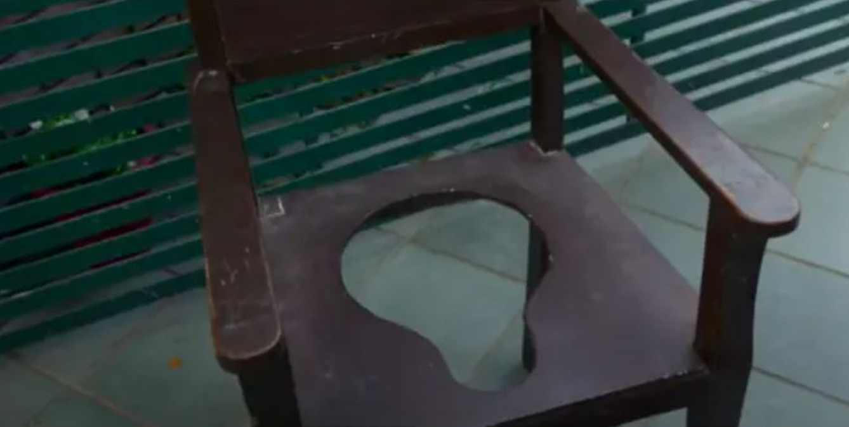
Image 4

Slide 34
Tie Breakers

Slide 35
"Maine Pyaar Kiya", "Hum Aapke Hain Koun", "Hum Saath Saath Hain" and "Vivaah" were family dramas directed by Sooraj Barjatya. Which of the following actors or actresses appeared in all four films?
Anupam Kher
Mohnish Behl
Reema Lagoo
Dilip Joshi (Jethalal)

Slide 36
Which movie is Amitabh Bachchan's Bollywood debut ?
Saath Hindustani
Anand
Bombay to Goa
Guddi

Slide 37
The iconic dialogue “Aaj mere paas bangla hai, gadi hai, bank-balance hai – tumhare paas kya hai ?” is from which movie ?

Slide 38
The famous dialogue “Har team main bas ek hi gunda ho sakta hai aur iss team ka gunda main hoo?” is from which movie ?

